Slide 1
Virtualizer Studio: TLM Creation
Quickstart Training – Importing SystemC Models
© 2024 Synopsys, Inc. All Rights Reserved
Notes:
Welcome to the module 5 of the TLMC QuickStart training - Importing SystemC Models!

Slide 2
CONFIDENTIAL INFORMATION
The information contained in this presentation is the confidential and proprietary information of Synopsys. You are not permitted to disseminate or use any of
the information provided to you in this presentation outside of Synopsys without prior written authorization.
IMPORTANT NOTICE
In the event information in this presentation reflects Synopsys’ future plans, such plans are as of the date of this presentation and are subject to change. Synopsys is not obligated to update this presentation or develop the products with the features and functionality discussed in this presentation. Additionally, Synopsys’ services and products may only be offered and purchased pursuant to an authorized quote and purchase order or a mutually agreed upon written contract with Synopsys.

Slide 3
Agenda
Introduction
  Virtualizer Studio Overview + TLM Creation Flow
Part 1: Model Skeleton Creation
  Model interfaces, memories, registers, build settings, IP-XACT import, etc.
Part 2: Test Driven Design Methodology
  Unit testing framework, test utilities, functional coverage, etc.
Part 3: Model Behavior Implementation
  Default and custom callbacks, continuous assignments, etc.
Part 4: Model Debugging
  SystemC debugging, using FastTrack messages, source code debugging, etc.
Part 5: Import of Existing SystemC Models
Part 6: Model Integration in Virtual Prototype Design
Notes:
Look into the overview to get an insight into the training contents.

Slide 4

Objectives
After completing this module, you should be able to:
Import an existing SystemC model in a TLM Creator project
Review the components and configurations of the imported model
Synchronize / Re-Import the model for the subsequent updates

Slide 5
Importing SystemC Models
Steps to import SystemC model
Synchronizing / Re-Importing the Model
Reviewing the imported module
  Parameters
  Interfaces
  Memories
Notes:
In this section, we will begin with how to import SystemC models in the TLM Creation perspective of Virtualizer Studio. Next, synchronizing and re-importing the model. Lastly, steps to review or edit the parameters, interfaces, and memories of the imported model.

Slide 6
Importing Existing SystemC Models
Importing existing SystemC TLM Models into TLM Creator
TLM Creator does not (re)create any of the SystemC code but wraps the model in a layer of meta information and packages it
The wrapped model can be used seamlessly in VDK Creation or in Platform Creator
This flow is typically used when you already have SystemC models or testbench parts (either written manually or as a product of other flows) that are to be used in a VDK
Notes:
Alternative to the model creation, TLM Creator also supports a SystemC import flow, which allows you to add an existing SystemC code into your TLMC project in Virtualizer Studio.
While importing, the tool simply creates a wrapper around the code in a layer of meta information and packages it. It does not recreate any part of the model. After that it can be seamlessly used in the VDK Creation tool and integrated in a VDK design same as a TLM model. Likewise it can be also used in Platform Creator.
This flow is helpful when you already have SystemC models or testbench (written manually or as a product of other flows) that are to be used in a VDK.

Slide 7
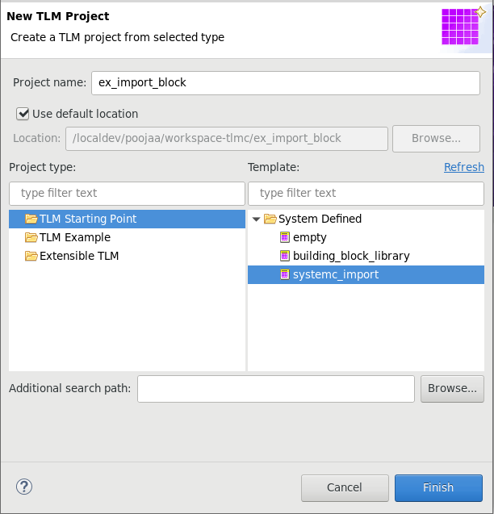
Create a New SystemC Import Project
The starting point for SystemC import is a dedicated TLM Creator project type:
Create a new TLM project in the
New TLM Project dialog:
  Type a Name for the project
  Select systemc_import from
  the Model templates
  Click Finish
Notes:
To create a new SystemC Import project in Virtualizer Studio, initiate to create a new TLMC project and specify the following in the New TLM project dialog.
Type a name for the project,
Select TLM Starting Point project type, and select systemc_import from the templates
Click Finish to proceed.

Slide 8
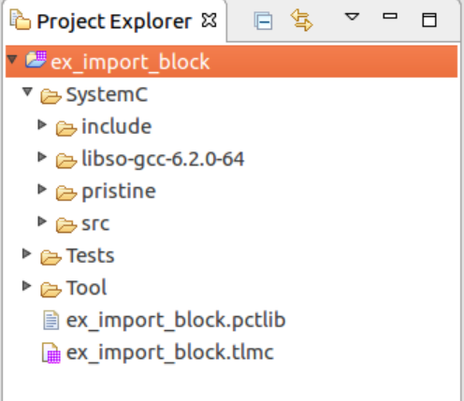
Bring the SystemC Sources into the Project
The SystemC model components have to be
included in the TLMC project
Options to bring
the sources in:
Specify main header file and src files in Build settings + add include directives to locate remaining header files
Create project links to the existing file
Move the file into the project directories
SystemC model ex_import_block
Directory structure
Ex_import_block/
include/
block.h
utils.h
src/
block.cc
Required Compiler settings
Preprocessor
-DMODE
-I$(REPO)/include
Required Linker settings
-L$(REPO)/lib –lxzy
Notes:
After creating a skeleton project, you need to include the SystemC model component. You can do so by adding links to the model code files or add them directly into your project structure under the SystemC folder (model header and code files in the include and src folders, respectively). Thereon, you need to add the required compiler and linker settings. Lets take a look at how to do these steps.

Slide 9
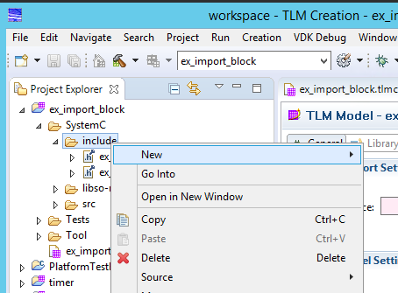
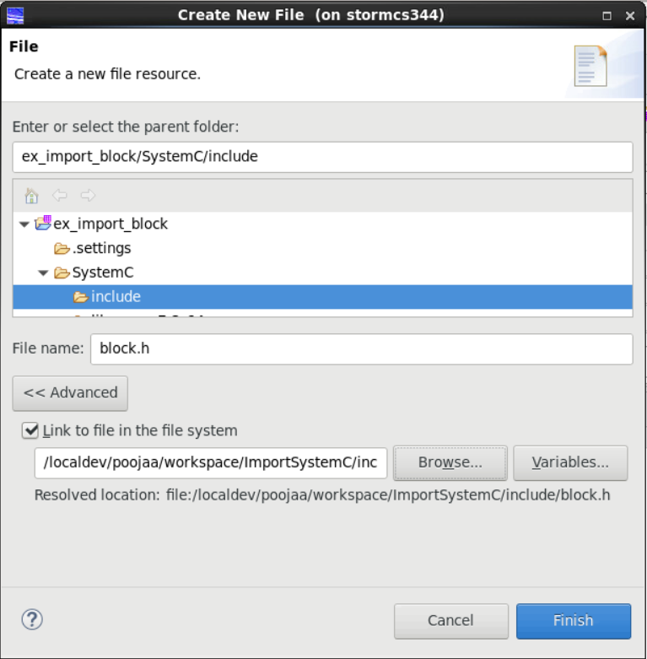
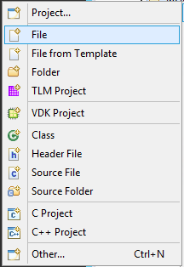
Creating Links to Bring in Source Files
First create a new file in the
include or src folder
In the New File dialog, check the Advanced button to create a link and set the path to the source file
Notes:
For creating links to the SystemC code files, create a new file in the include or src folder from the Project Explorer view using the context menu option. In the New File dialog, select the option to link a file from the file system from the Advanced options and click Finish.

Slide 10
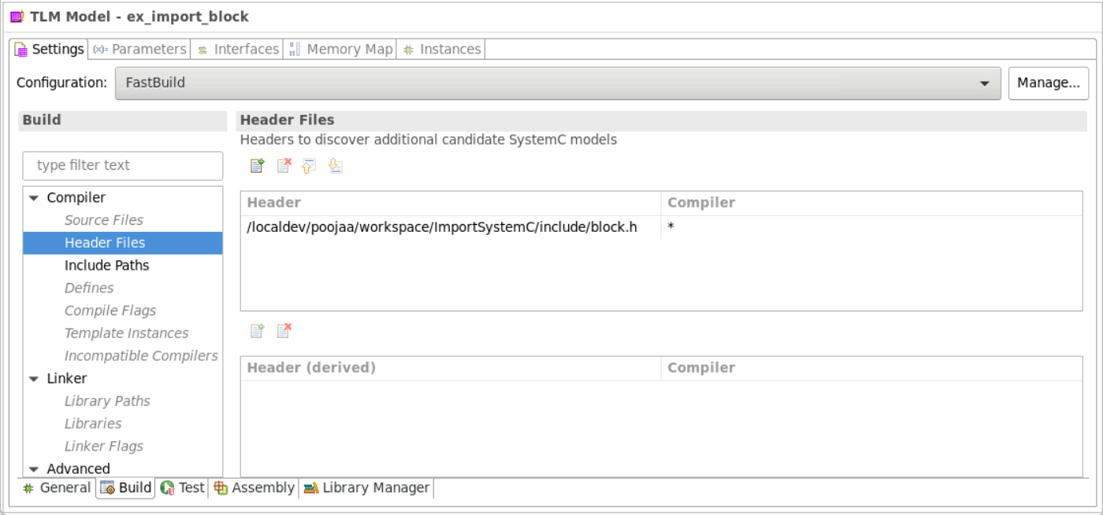
Configure the Preprocessor + Linker Flags
In the Build page of the Settings tab, you can add all build and export related settings for the project
SystemC model ex_import_block
Directory structure
Ex_import_block/
include/
block.h
utils.h
src/
block.cc
Required Compiler settings
Preprocessor
-DMODE
-I$(REPO)/include
Required Linker settings
-L$(REPO)/lib –lxzy
Notes:
Next to add the Build and Assembly settings – i.e. compiler and linker settings related to the build and export, open the Build page of the Settings tab of the Model editor and use the appropriate options. This will set the build and export setting for your project.

Slide 11
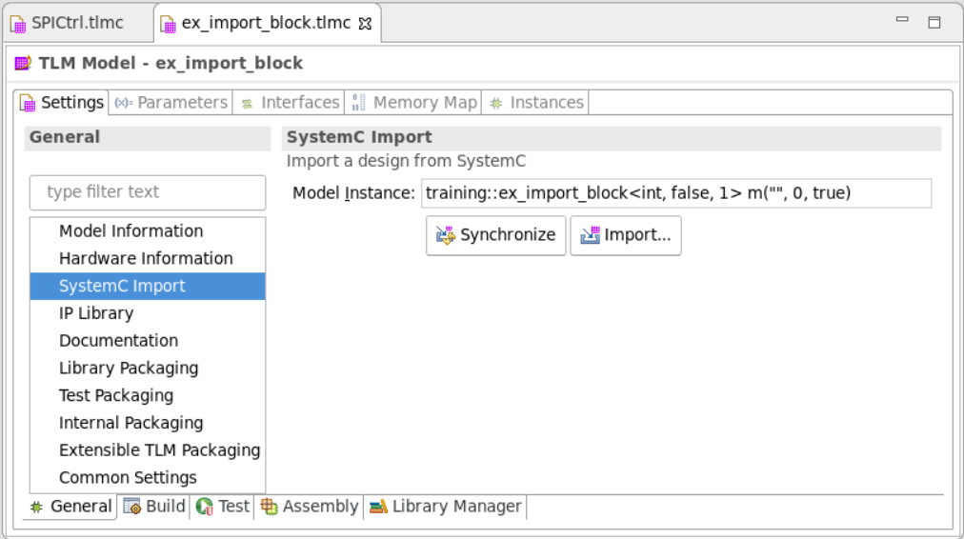
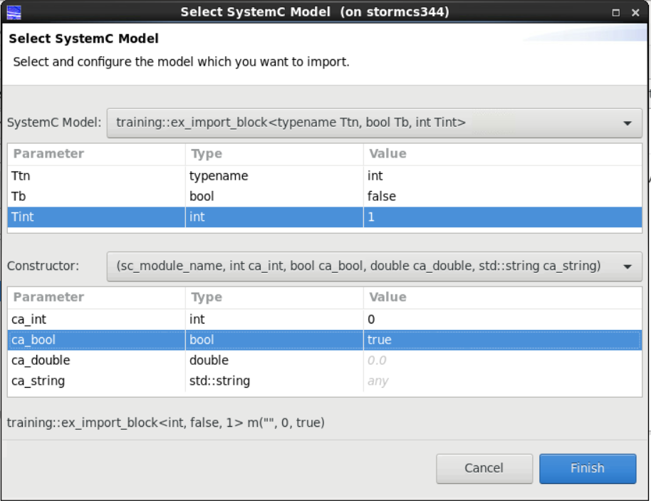
Starting / Configuring the Import Process
With complete sources and
build configuration you can
start the actual import
In the Select SystemC Model
dialog, pick the SystemC model
to import from the pull down
list
  For template models, provide
  (default) template parameters
  Pick the constructor and provide
  default constructor arguments
Notes:
Now that we have done the ground work, let’s start with the actual import. Open the General page of the Settings tab of the model editor and select to open the SystemC Import section. Select the model instance to be imported. It should contain all namespace definitions, model class, template parameters and constructor arguments.
Click Import to start. The Select SystemC Model dialog appears listing the model details. Review the values for the template parameters and make changes as required. Also, check the default arguments for the constructor.
Click Finish.

Slide 12
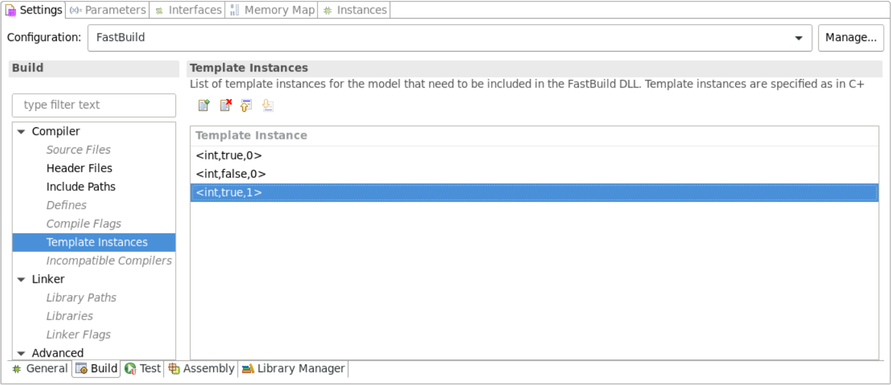
Adding Template Instances
For FastBuild, add all required instances of the template parameters in the Build page of the Settings tab
Virtualizer FastBuild will prebuild a DLL for each value set
Notes:
Note that after defining the template parameters for the SystemC model, you will also have to define the template instances that need to be compiled into the model D LL. This can be done in the Build page of the Settings tab under the Compiler options for the FastBuild configuration. Ensure that the parameter constraints match the template instances that are available.

Slide 13
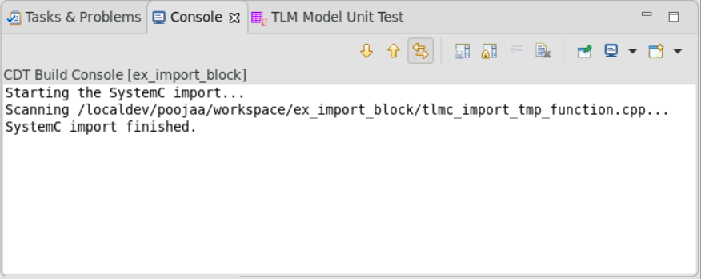
Synchronizing / Re-Importing the Model
After import the Model Instance field is populated
You can Synchronize every time you change your SystemC source code description or Build settings
Use Import when you want to use the explicit dialog box to specify different parameters or constructor
Notes:
You can synchronize the model definition whenever the SystemC code gets updated. Open the SystemC Import section in the General page of the Settings tab, select the updated model source and click Synchronize. If you want to specify different parameters or constructor argument values, use Import.

Slide 14
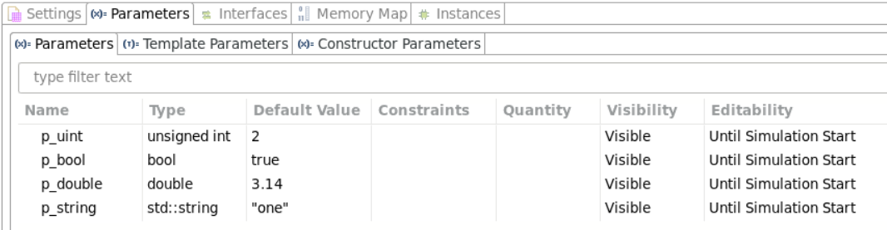

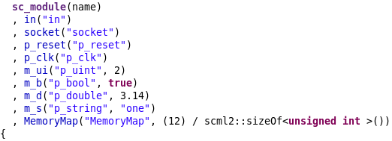
Parameters of the Imported Model
All SCML properties are imported as parameters with the same name as given in the scml_property constructor
You cannot add, remove, rename parameters, or change their type
You can change meta information of parameter such as, their Default Value, Constraints, Visibility, Value, Editability, and Description
Meta information is packaged into the TLM Creator model, and used in tools like VDK Creator or Platform Creator
Notes:
As part of the import, the SCML properties of the component are identified as parameters. Switch to the Parameters tab to review them. It is not possible to add, remove, rename or change the type of a parameter. To complete the definition, their default value, constraints, visibility and editability attributes, value and description should be added.

Slide 15
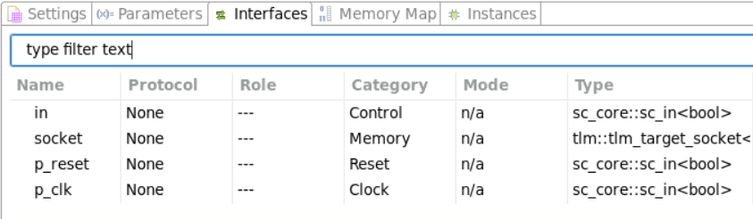
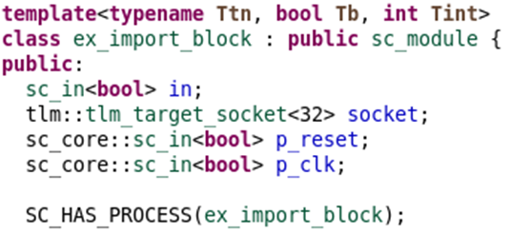
Interfaces of the Imported Model
All Interfaces are imported with the same name as given in the model header
You cannot add, remove, rename interfaces, or change their type
You can change meta information of interfaces such as, their Category, Active Level for Reset ports, and Description
Meta information is packaged into the TLM Creator model, and used in tools like VDK Creator or Platform Creator
Notes:
All Interfaces are imported with the same name as given in the model header. Switch to the Interfaces tab to review them. You can not modify the name, type and quantity of the interfaces. To complete the definition of the category, active level for Reset ports and description should be reviewed.

Slide 16
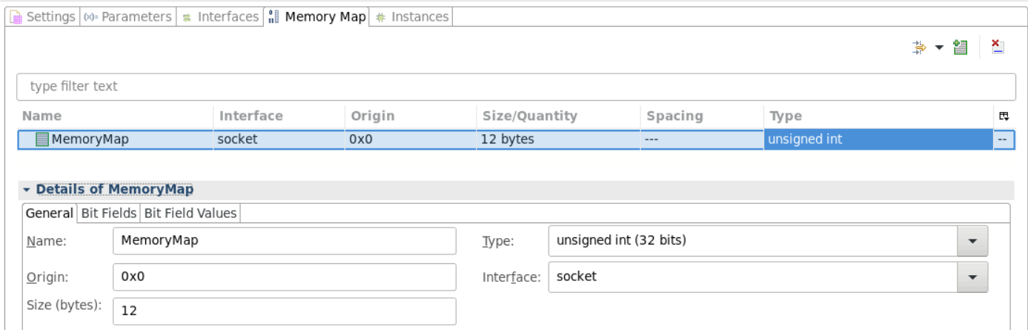
Memories of the Imported Model
Memories, registers, and bit-fields are not imported. You need to add the memories associated to target sockets in this tab manually so that at the time of export, the right target locations are created
Target locations is metadata that is passed to VDK Creator or Platform Creator for use during the VDK assembly page, indicating the size of the memories behind the target socket
Note: Adding registers, bit-fields, callbacks
etc. is disabled in the TLM Creator GUI for
imported SystemC models, as source code
generation for imported SystemC models is
not supported
Notes:
The SystemC import feature will not import any memory, register and bitfield definition. Even adding new registers, bit-fields, callbacks etc. is disabled in the TLM Creator GUI for
imported SystemC models.
The only information that is needed to enable a component in the authoring tool is to indicate which interfaces should be represented in the memory map and what size they should occupy in a memory map. This is done using the Target Locations feature of the XML library format. For more details, refer to the VP documentation.

Slide 17
Hands On Labs on this topic
Module 3 Lab A: Import Existing SystemC TLM Models
Import an existing SystemC TLM Model
This flow is used when you already have SystemC models or testbench parts that shall be used in a Synopsys Virtual Platform
Start with the SystemC source files provided in the lab data package and import it in your TLM project
The tool extracts the model properties from the C++ source code.
Then build the project so that the model can be used for platform creation
Notes:
Accompanied Lab Modules Overview!

Slide 18

Thank You

